Slide 1
Fine Industries
Presentation By:
Abdul Rehman Shaukat
Jehanzeb Shahzad
Mirza Kashif Ijaz
Muhammad Usman
Zain Khan

Slide 2
Objective
The primary objective of this report is to find out and study how operations management aligns with the operations of the company that we chose i.e., ‘Fine Industries’.
This report provides a detailed review of how the company carries out its operations.
We analyzed the company’s operations, competitive strategies, competitive priorities and the direct competitors of the company.
Found out how the company managed its production, labor and day-to-day activities.
Highlighted potential improvements which could further help to improve its operations.

Slide 3
Introduction
Fine Industries’ is a private textile company which was founded in 1998. It expands over three acres located 17 km from Raiwind Road, Lahore, Punjab, Pakistan.
The company specializes in woven fabrics, cotton, polyester cotton and chief value cotton.
The company had started off its operations with just 8 weaving machines and more or less 20 employees.
It now sits at 35 machines and over 70 employees working 24/7.
The company offers a wide range of designs and dyed fabrics according to the clients’ needs.
It produces 9000,m of fabric with up to 12,000m as per demand.

Slide 4
Process Flow Chart
Manufacturing Execution Start
Yarn Preparation in the Yarn Industry
Yarn Doubling and Twisting
Winding
Sizing
Winding to the Weavers Beam
Drawing
Denting
Looming
Weaving
Take off the Fabric Role
Fabric Inspection
Delivery
End
Used to double the size of the yarn and twist it in order to make the yarn stronger.
Winding the yarn onto the cone.
The yarn is removed from the cone and winded to the cone where starch is added to the thread.
After the sizing process, the yarn is winded on to the weaver beam which is later placed on to the loom.
Drawing is done to pull the threads through the frame of weaving machine.
Denting signifies drawing the thread according to the reed plan. (Specifies the fabric width and ends per inches
When the new warp beam arrives from sizing. It is attached to the old threads of the beam.
Finally Weaving is started and others process will be followed for delivery.

Slide 5
Competitive Priorities
“speed of the production process”.
competitors are capable of producing apparel
competitors rarely compete on price
to indulge in price wars is to demean their relationship
the industry competes on speed and time
firms with the highest amount of production speed get to cater to most of the market.

Slide 6
Competitive Priorities
Fine chooses to use old machinery, which was made in the 80s
new machines, like Airjet, are not capable of producing silk
Silk is prone to damage if preciseness is compromised
Old machines are slow but they are extremely precise so Fine uses old machines to maintain versatility in their product line.

Slide 7
Competitive environment
Competition in the market is fierce but not hostile
However, it is imperative to maintain speed as there is a fixed delivery time for customers
B-to-B sales so any delay in delivery causes significant loss of output of the customer
has remained competent in this department and it aims to be the fastest producer in the entire industry.

Slide 8
Competitive strategy
intricate product knowledge
They have maintained speed and quality
secret is to use old machinery and make them work round the clock.
Old machinery allows Fine to be versatile
Old machines are slow
Fine runs the machinery 24/7 in order to compensate for lost time
Fine hires competent workers only and pays them generously

Slide 9
Competitive Strategies
Order Winners
Providing Top Quality
Flexibility

Slide 10
Competitive Priorities
Quality
  top and consistent quality
  similar competitive strategy of Shafi Textiles and Zaifer Textiles (direct competitors)
  industry average of defect rate is around 5-7 percent
  promises and delivers a defect rate of lower than 1-2 percent
  buy’s the best quality raw material from companies such as Nishat
  fixed suppliers
  extensive quality checks
  completive edge that only a few companies including Fine Industries have the machinery to produce high quality silk.

Slide 11
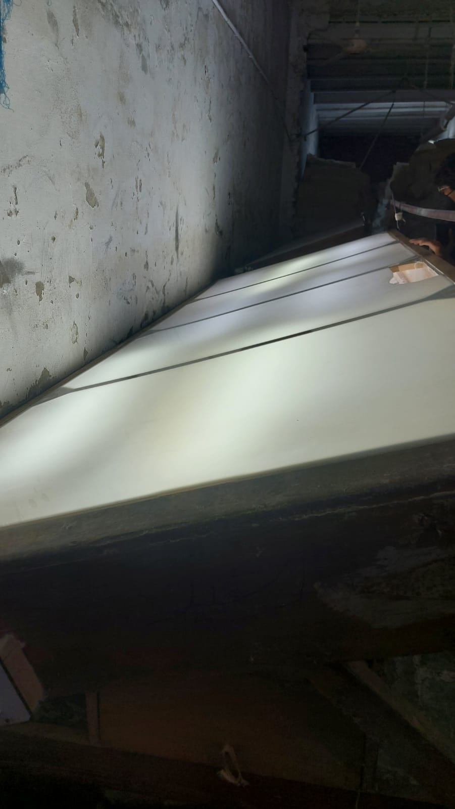
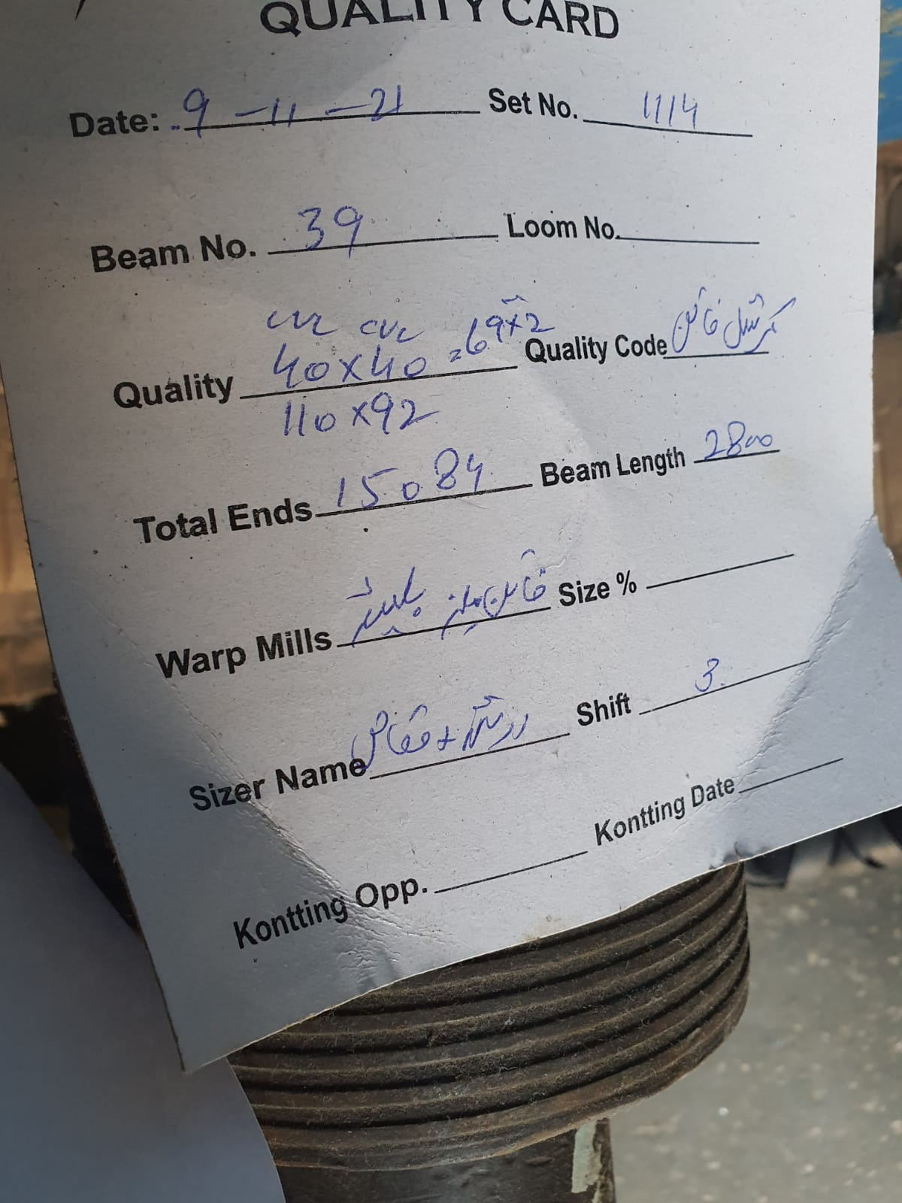
Quality Check Table
Quality Card

Slide 12
Competitive Priorities
Flexibility
  flexibility in terms of customization and output size
  excess capacity machinery
  excess workers hired on full time basis
  can produce almost any type of cloth being it a single shade, multiple shades or one design or even multiple designs

Slide 13
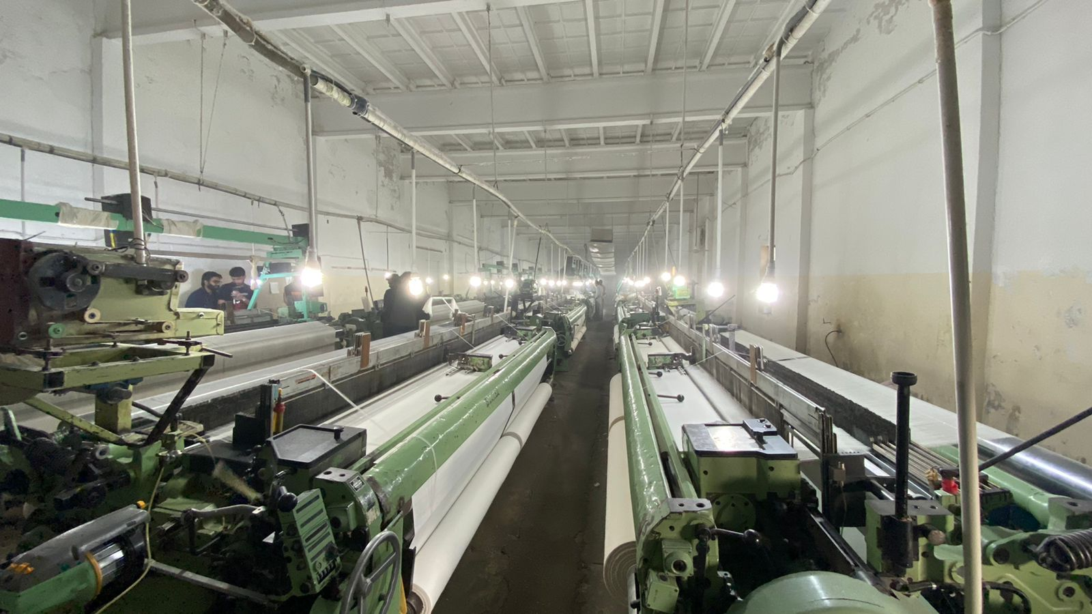
Capacity

Slide 14
Problems Identified
Labor
They employ over 70 employees and have accommodation of less than 15% of their labor. (12 employees)
The 24-hour work day is divided into three shifts with each shift being 8 hours long.
Each shift requires 20 workers to keep the 30 machines running.
They accommodate 10 machine workers and 2 guards on the facility.
Therefore, during the night shift only half of the production is done.

Slide 15
Proposed Solution
Build accommodation for 10 employees in
the un utilized land.
Advantages
  More workers would be available on facility which
  would lead to increase in production levels during all shifts.
  More production would increase revenues to the firm

Slide 16
Problems Identified (Cont.)
Material Handling
They only weave the cloth which means that they have to send the yarn to other firms who provide them with the facility of sizing.
The packaging of yarn is in boxes.

Slide 17
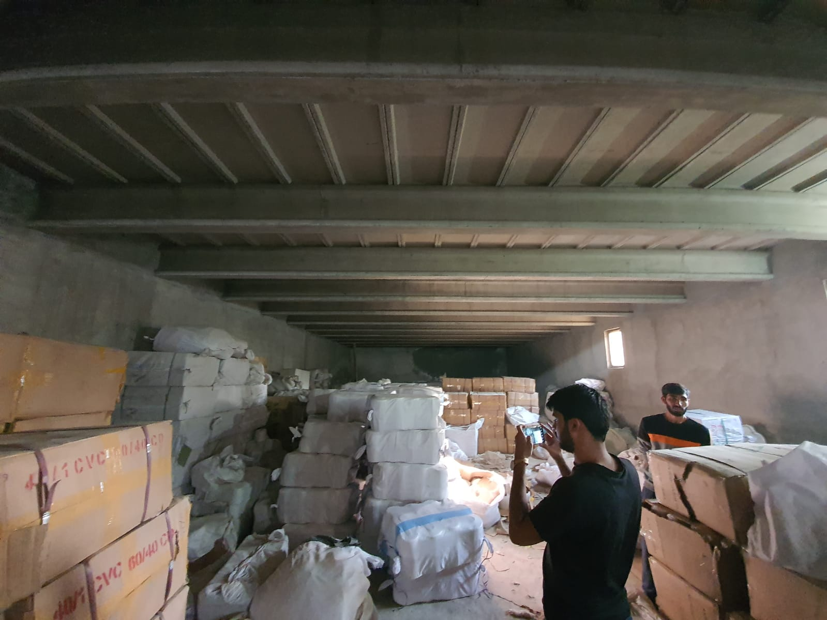
Packaging of Yarn (48-50kg)

Slide 18
Problems Identified (Cont.)
Material Handling
They only weave the cloth which means that they have to send the yarn to other firms who provide them with the facility of sizing.
The packaging of yarn is in boxes.
Unloading of large spools from the sizing unit is also extremely hard, manual chain hoist is used for that purpose.

Slide 19
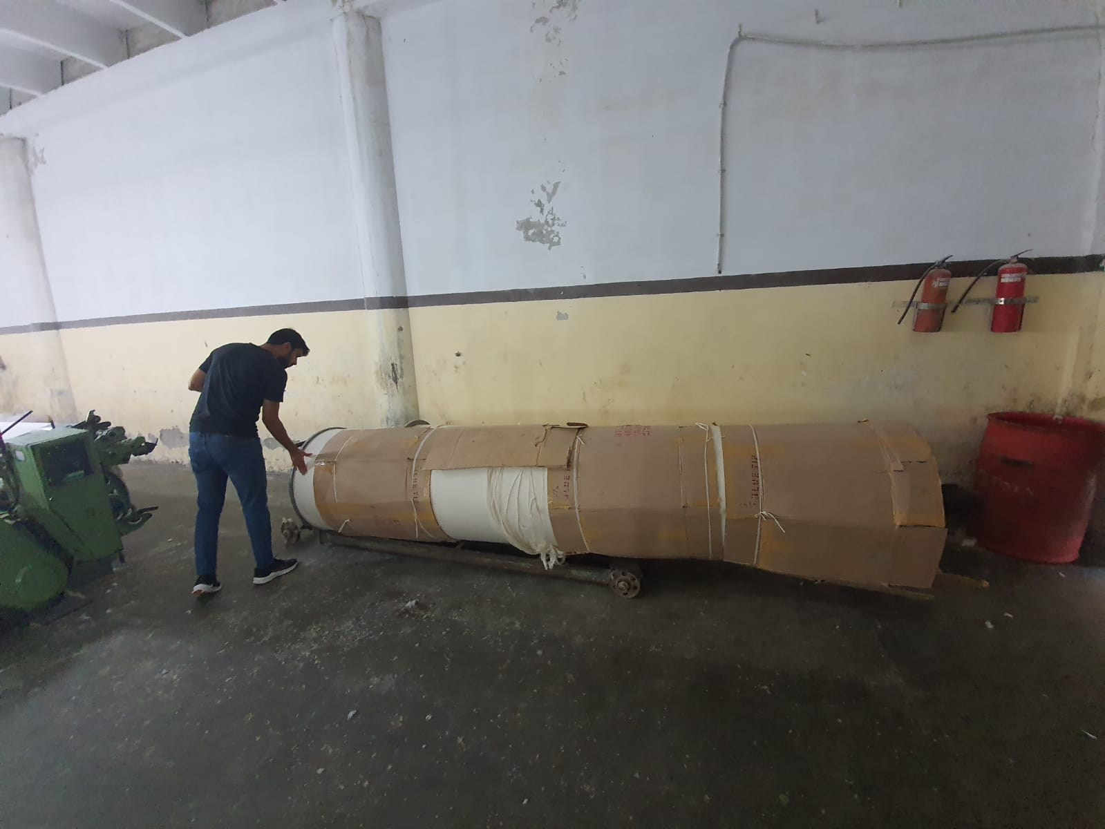
Large Spools (3.5 Tones with yarn and 300kg empty)

Slide 20
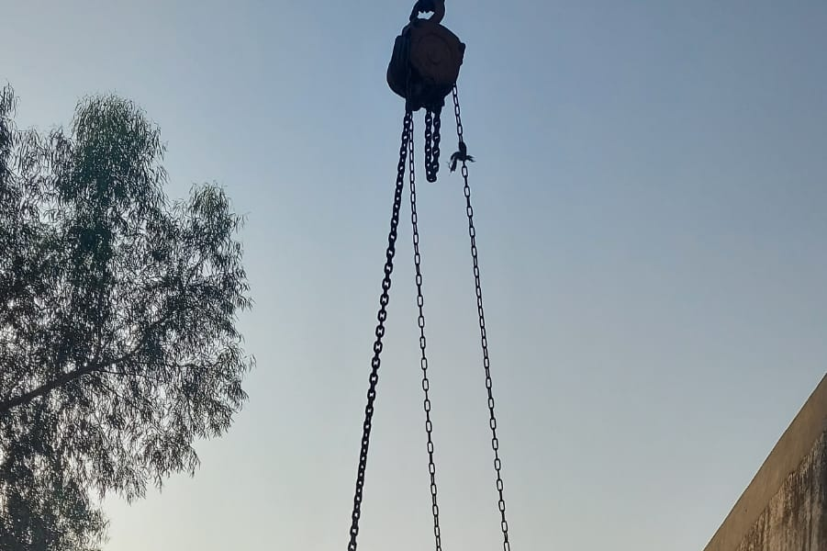
Problems Identified (Cont.)
Material Handling
They only weave the cloth which means that they have to send the yarn to other firms who provide them with the facility of sizing.
The packaging of yarn is in boxes.
Unloading of large spools from the sizing unit is also extremely hard, manual chain hoist is used for that purpose.

Slide 21
Proposed Solution
The job can be made easier and more time effective for the employees if a fork lifter was utilized for the purpose.
Material produced can be stored on pallets which can then be lifted via lifter and loaded into the trucks easily.
Manual fork lifter would make the job of carrying the heavy boxes and large spools to the stores and then to production facility easier.

Slide 22
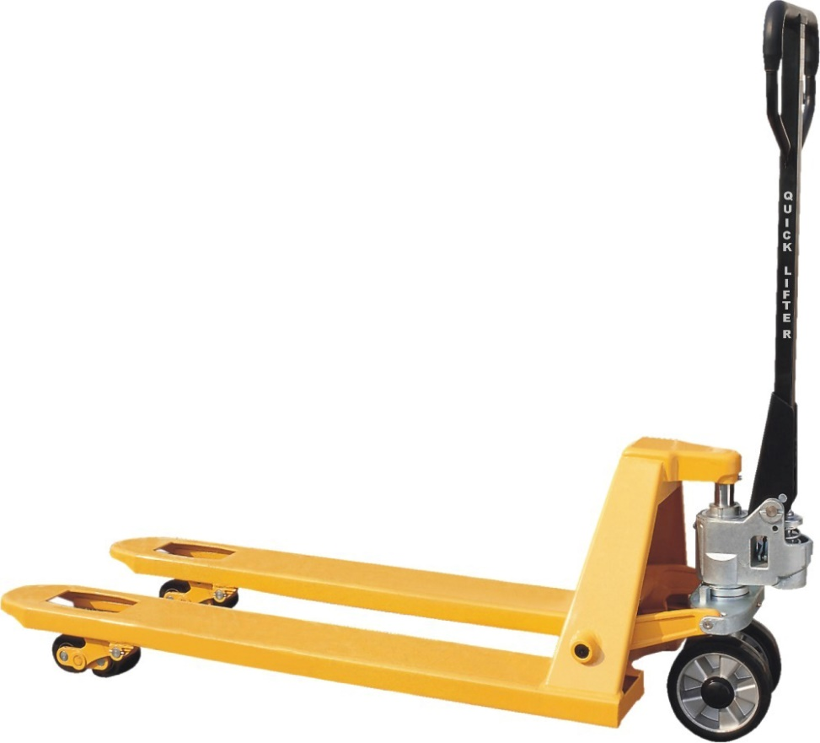
Manual Fork Lifter

Slide 23
Proposed Solution
The job can be made easier and more time effective for the employees if a fork lifter was utilized for the purpose.
Material produced can be stored on pallets which can then be lifted via lifter and loaded into the trucks easily.
Manual fork lifter would make the job of carrying the heavy boxes and large spools to the stores and then to production facility easier.
Manual hydraulic fork lifter are readily available in Pakistan which can lift the pallet to a trucks height to make loading unloading easy.

Slide 24
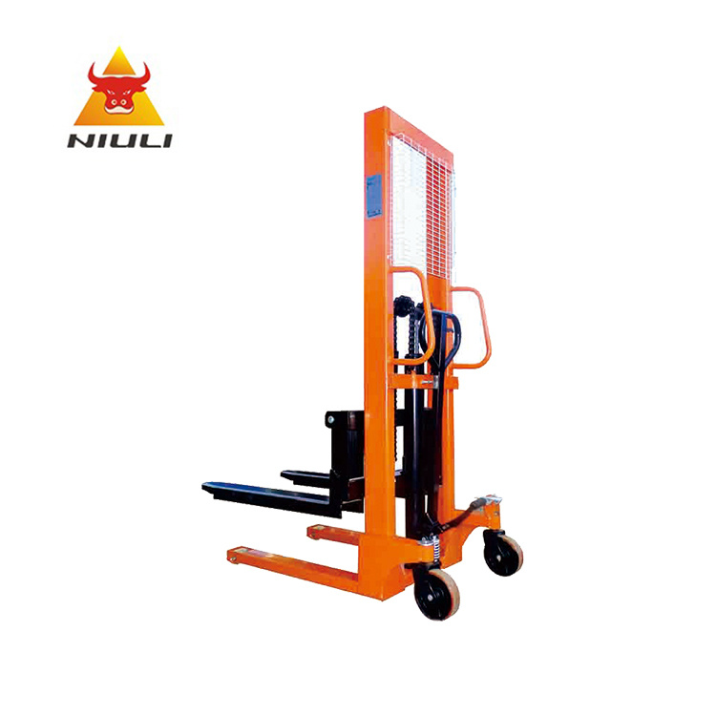
Manual hydraulic fork lifter

Slide 25
Proposed Solution (Cont.)
The job can be made easier and more time effective for the employees if a fork lifter was utilized for the purpose.
Material produced can be stored on pallets which can then be lifted via lifter and loaded into the trucks easily.
Manual fork lifter would make the job of carrying the heavy boxes and large spools to the stores and then to production facility easier.
Manual hydraulic fork lifter are readily available in Pakistan which can lift the pallets to a trucks height to make loading unloading easy.

Slide 26
Problems identified (Cont.)
Cameras
Facility had no CCTV camera installed
Labour commit Fraud
Needed to instil fear in employees
Stop unnecessary delays in Production
Loss on revenue due to capacity gaps

Slide 27

Proposed Solution
Set up a night vision camera for industrial purpose
Lorex American brand 16 Cameras (32-Channel NVR System with 4K (8MP) IP Cameras) Costs: 310000 Rupees
Advantages:
  Employees fear being watched
  Lazy employees identified replaced with more productive
  No unnecessary halt of production
  Better Productivity as loop holes identified

Slide 28
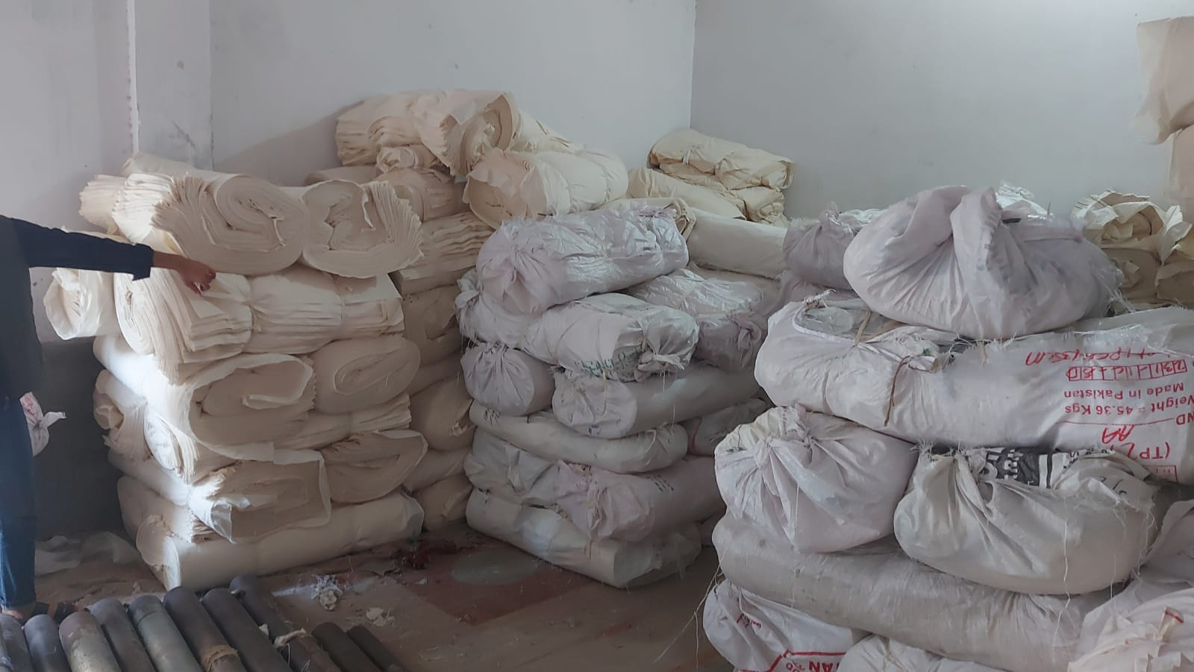
Finished Goods Hall
Production Hall

Slide 29
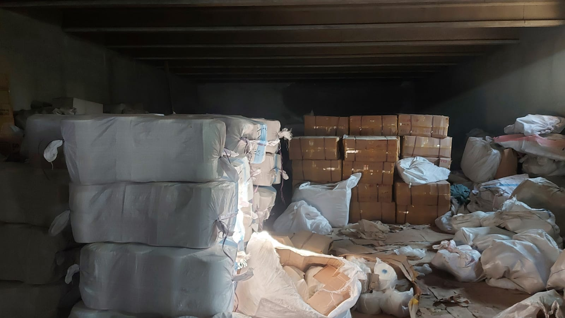
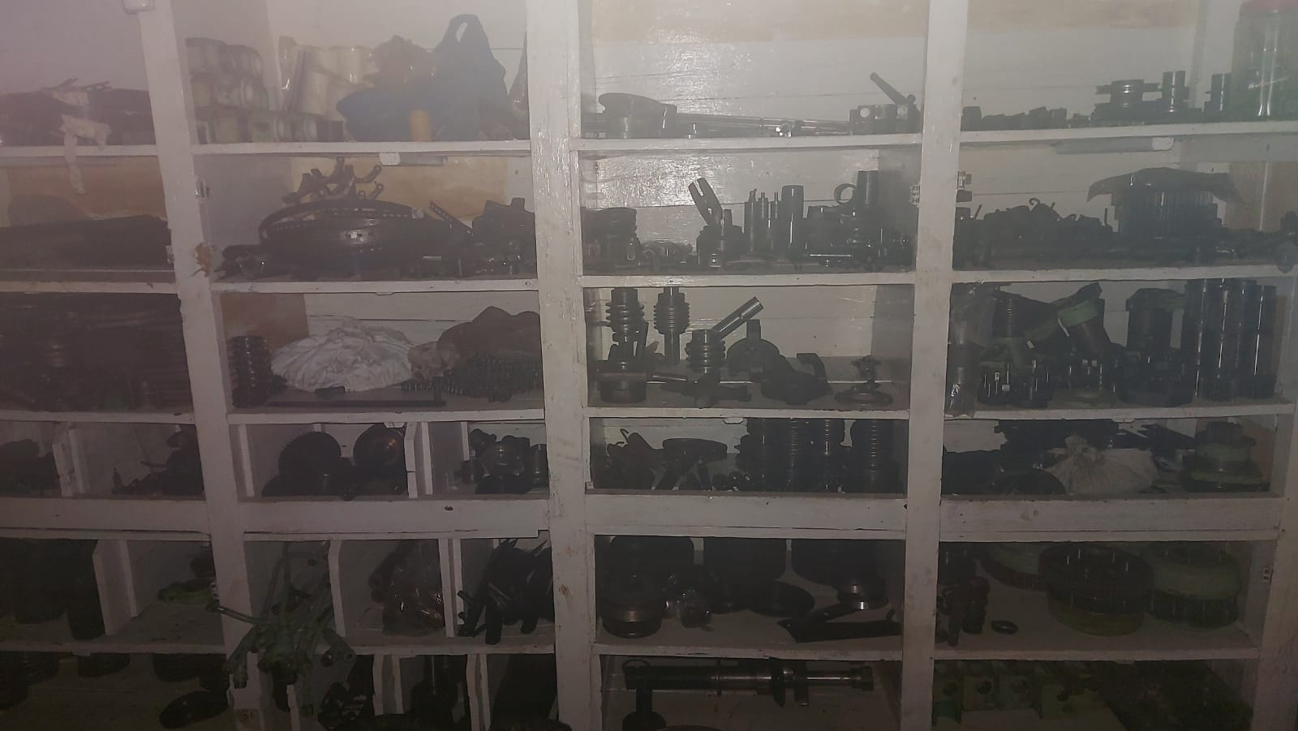
Raw Material Hall
MRO(Maintenance/repair/operating) Inventory

Slide 30
Problems identified (Cont.)
MRO (Maintenance/repair/operating) Inventory:
Vital part of a manufacturing plant (300+ items)
Parts usually missing from store
Halting a particular machine stopped production, order delays
Plant located far from city
Increasing Idle labor and costs due to production halt
Proposed Solution
Again Use of CCTV footage to identify thief's

Slide 31
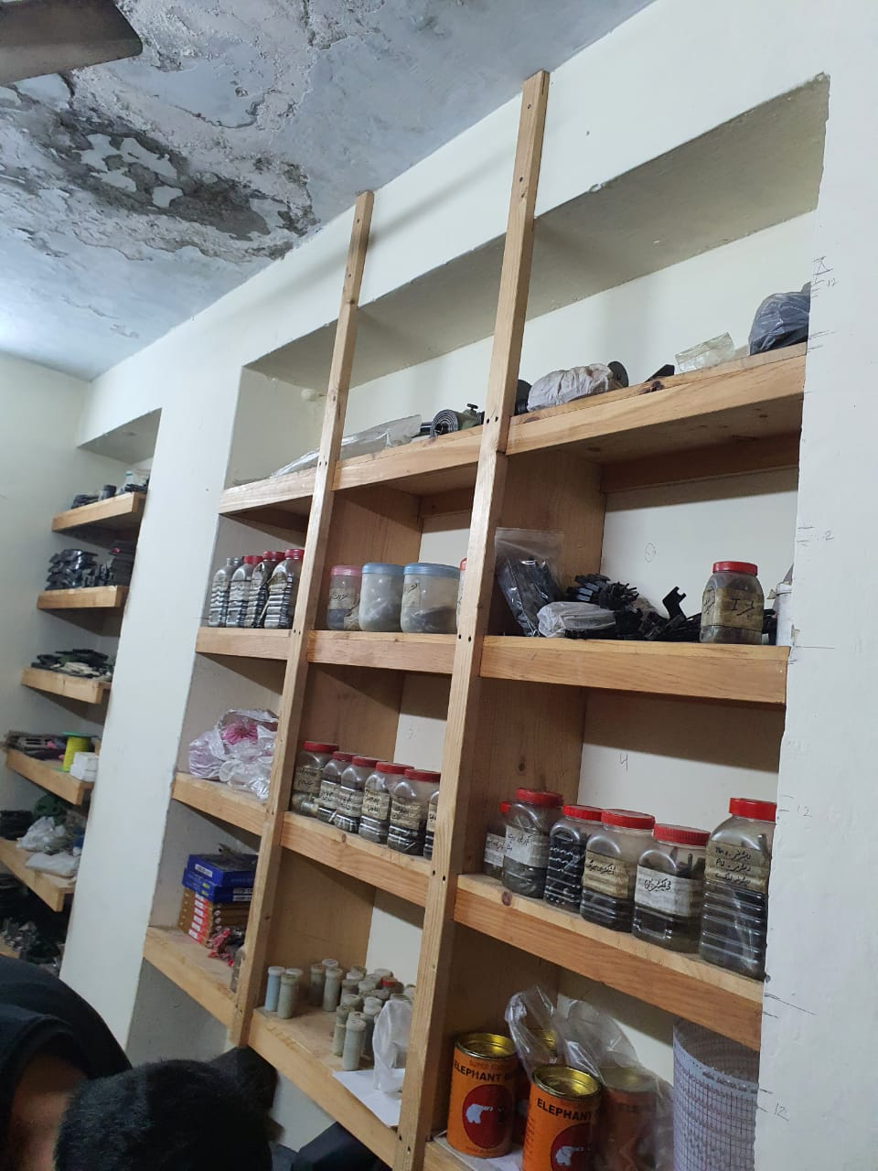

Slide 32
Problems identified (Cont.)
Security
Stock can be stolen due to little height walls on both sides
Stolen at peak times or night times
Little walls can became a robbery cases
Proposed Solution
A trusted person accommodated in the plant
Monitoring labor activities
Act as a laborer stopping any fraud activities

Slide 33
Problems identified (Cont.)
Technology
Outdated manual report making
Use excel sheets to maintain stock
Leading to major inconveniences if system corrupts
Proposed Solution
Use software specially designed for their business
Easy Stock management
Convenience for owner to view stocks and reports on the go

Slide 34
Proposed Solution (Cont.)
Less labor needed (one database entry)
Labor can do other tasks too
Server maintained in case of emergencies
Companies to contact for Software Making
MAB Biz Solutions (600000 rupees custom software, 20000 Retainership)
Business Enhancement Technology (350000-400000 rupees)

